Slide 1
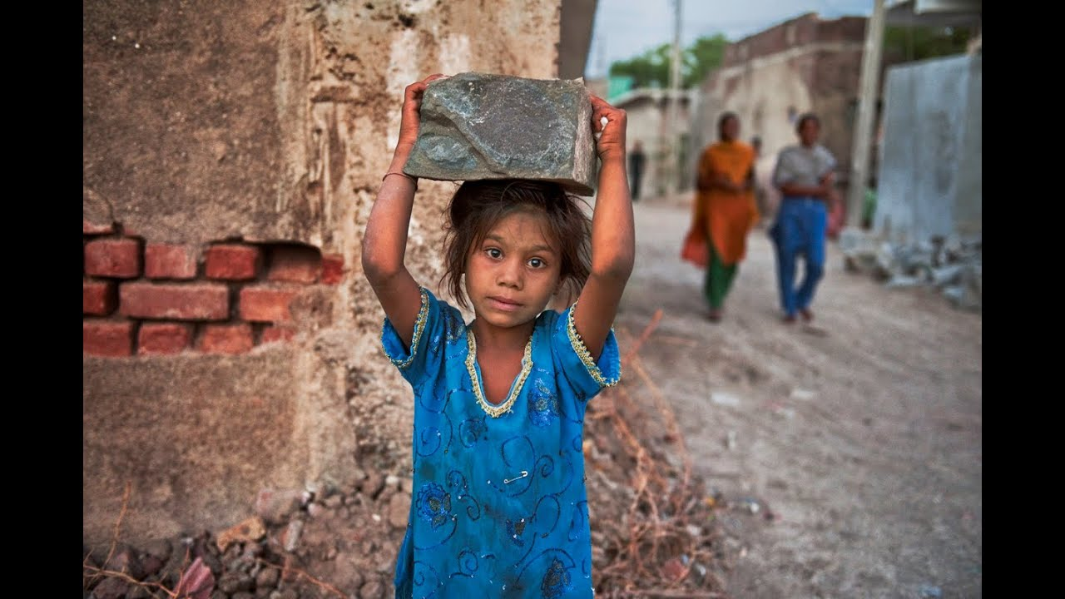


CHILD IS MEANT TO LEARN, NOT TO EARN
Dream
Reality
HOW ABOUT FINANCIAL HELP SYSTEM AT SCHOOLS ?
Notes:
This is an important problem around the world. I am sure you know about this problema. 1 in 10 children worldwide are 'out-of- school'.
The main cause is based on Poverty and children go to work instead of go to learn.
A Child, is Meant to Learn, Not to Earn.
We have an idea to help to you to get a child dream to reality.
<Next Slide Please>

Slide 2








Fujitsu Financial Help System is a platform that brings NGOs & Sponsors
connected with Children
FUJITSU
DIGITAL DISRUPTIVE TECHNOLOGIES
& SPONSORSHIP
(Blockchain, AI, Paas, Smart contracts, Deep Learning)
NGOs,
Governments,
Suppliers & Partners
CONNECTED
MORE CHILDREN GOING TO SCHOOLS
Value Proposition
Optimize the NGOs Operational Cost.
Maximize outreach to Sponsors
Benefit more children & schools.
Notes:
NGO, Governments, Individuals and Companies via CSR programs are supporting them but evidently it help is not enough.
Business Proposed is: That is why we decide create a SMART FINANTIAL HELP PLATFORM using disruptive technology & Sponsorship by Fujitsu. Which will support to NGO focused in a same problem we are trying to solve. INCREASE quantity of children going to school, improving school infrastructure, including water, sanitation, food and support the economic activities of parents of children in risk of child labour
For NGOs who want to Provide best schooling for underprivileged children by minimizing their costs, the Fujitsu Financial Help System is a platform that brings NGOs, Sponsors connected with Children

Slide 3
ASSESSMENT | Impact (Stakeholders) analysis
Sponsor (Fujitsu)
Contribution to society (CSR)
Publicity of Fujitsu technology
Employees’ Experience
Profit from new solution
Customers (NGOs)
Reliability and Traceability of donation
Optimization of work
Increase Funders Trust due to transparency
Community & Governments
Decrease the number of children who cannot go to school
Contribute to SDGs target 4
Cost reduction
Connect Supporters and Receivers

Slide 4
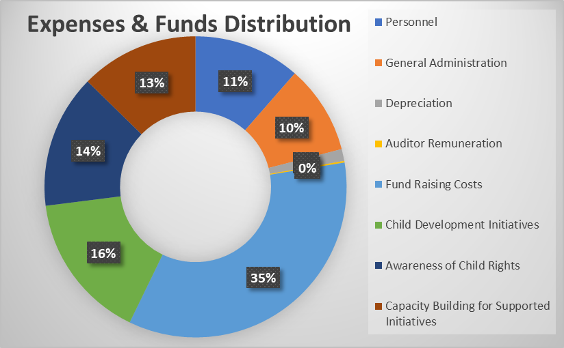

ASSESSMENT | Funds optimization under NGOs
Use Case: “ Child Rights and You “ NGO from India
Expense and Fund Distribution Head | Solution Impact
Personnel | Reduce
General Administration | Reduce
Depreciation | Optimize
Auditor Remuneration | Neutral
Fund Raising Costs | Reduce
Child Development Initiatives | Increase
Awareness of Child Rights | Increase
Capacity Building for Supported Initiatives | Optimize
* Reference – Child Rights and You, India Annual Report

Slide 5

ASSESSMENT | Sponsors Financial Analysis
Assumptions:
Investment 900 KUSD
6 USD/year price per child fee
Starting with 5 NGOs deals 1st year
10000 covers are required by each NGOs
Notes:
NGOs adopt the FJ Solution by paying a nominal fee which helps in significant gains in terms of Optimal utilization and disbursement of Funds and overall cost savings

Slide 6
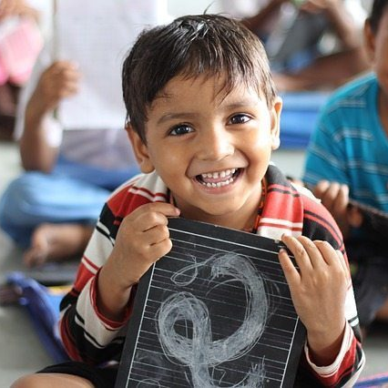
Fujitsu win 84% IRR
and possibility to develop new businesses
84%
Win NGOs
in cost saving & funds optimization utilization
30%
We decide GO!
..and you?
1.5M
New children
helped in 3 years
Let’s help children go to school together!
Notes:
NGOs adopt the FJ Solution by paying a nominal fee which helps in significant gains in terms of Optimal utilization and disbursement of Funds and overall cost savings
We call for action to,
Fujitsu, to help sponsor the Technology Platform.
We also encourage all Fujitsu employees to join the Task Force with help of Responsible Business enrolments.
Come, Join Us !! Let us make their Dream Come True
<End of Presentation>

